Slide 1
Applications of Bayesian Networks in the Age of AI
Session I: Evidence Centered Design
ACED Introduction
Diego Zapata-Rivera, Russell Almond, & Duanli Yan

Slide 2
Agenda
SESSION TOPIC PRESENTERS
Session 1: Evidence Centered Design Diego Zapata ACED introduction Gen AI and BNs
Session 2: Bayes Nets and Applications Duanli Yan
Session 3: Refining Bayes Nets with Russell Almond & Data Duanli Yan
Session 4: Bayes Nets with R Russell Almond

Slide 3
The Interplay of Design and Statistical Modeling
Statistical models must be selected/tailored according to the needs of the assessment
Such selection and adaptation is only meaningful in the larger context of the assessment design
Understanding the discipline of assessment design is a necessary prerequisite for statistical modeling
Evidence Centered Design is an assessment design framework with general applicability and utility

Slide 4
Test Design
Stakeholders
Requirements
Purpose of the test
Intended population
Prospective Score Report
Evidence-Centered Design
Claims
Validity
Specifications
Notes:
The first step in designing a test is to ascertain the purpose of the test. What is the intended use? Is it a test of general knowledge? Is it a test of minimum competence? It is a placement test? The more specific you can be at this point, the better able you are to design a successful test.
Test design should also consider the intended population. Test assemblers need to make sure they construct a test at the appropriate level of difficulty for the target population. For example, a history test designed for 10-year-olds will probably look much different than a history test designed for college students.

Slide 5
Evidence Centered Design
Evidence Centered Design (ECD) provides a mechanism for
Capturing and documenting information about the structure and strength of evidentiary relationships.
Coordinating the work of test developers in authoring tasks and psychometricians in calibrating the measurement model.
Documenting the scientific information that provides the foundation for the assessment and its validity.

Slide 6
Evidence Centered Design
The Evidence Centered Design process is a series of procedures which center around the questions:
“What can we observe about an examinee's performance which will provide evidence that the examinee has or does not have the knowledge, skills and abilities we wish to make claims about?”
“How can we structure situations to be able to make those observations?”
This process results in a formal design for an assessment we call the Conceptual Assessment Framework (CAF)

Slide 7
The Initial Frame
Why are we measuring?
What are the goals and the desires for use of this assessment?
Prospective Score Report
Who are we measuring?
Who would take the assessment?
Who would view results and for what purpose?
Goals of the assessment that represent the targets around which the rest of the design process is oriented

Slide 8
Conceptual Assessment Framework (CAF)
What we measure = Student Proficiency Model
Proficiency Model(s)

Slide 9
Conceptual Assessment Framework (CAF)
What we measure = Student Proficiency Model
How we measure = Evidence Model
Proficiency Model(s)
Evidence Models
Stat
Evidence
model
Rules

Slide 10
Conceptual Assessment Framework (CAF)
What we measure = Student Proficiency Model
How we measure = Evidence Model
Where we measure = Task Model
Proficiency Model(s)
Evidence Models
Task Models
Stat
Evidence
model
Rules
Features
1.
xxxxx
2.
xxxxx
3.
xxxxx

Slide 11
Conceptual Assessment Framework (CAF)
What we measure = Student Proficiency Model
How we measure = Evidence Model
Where we measure = Task Model
How Much we measure = Assembly Model
Assembly Model
Proficiency Model(s)
Evidence Models
Task Models
Stat
Evidence
model
Rules
Features
1.
xxxxx
2.
xxxxx
3.
xxxxx

Slide 12
Conceptual Assessment Framework (CAF)
What we measure = Student Proficiency Model
How we measure = Evidence Model
Where we measure = Task Model
How Much we measure = Assembly Model
Customization = Presentation & Delivery Models
Assembly Model
Proficiency Model(s)
Evidence Models
Task Models
Presentation Model
Stat
Evidence
model
Rules
Features
1.
xxxxx
2.
xxxxx
3.
xxxxx
Delivery Model

Slide 13
Activity 1: Driver’s License Exam
Redesign the driver’s licensure exam
Write down several claims you would like to make about people who receive a driver’s license
Group your claims into several proficiency variables related to the driver’s test
Do the claims hold for high, medium or low values of those variables?
Use Netica as a drawing tool and add your variables

Slide 14
Activity 1 (cont)
List a bunch of activities that you may want prospective drivers to do in their exam
What is environment of the task
What are manipulable features of the task?
Pick one of the tasks you created and build an evidence model for it.
What are some observable outcomes? their possible values?
Which proficiencies do they measure?

Slide 15
Activity 1 (cont)
Think a bit about putting this driver’s test together
How many tasks do we need of what types?
How much time will be spent in written tests? On the road? In simulators?
How do we verify the identity of applicants?

Slide 16
ECD  Bayes Nets
Represent Qualitative ECD argument with a graph (Domain Modeling) (Session I)
Turn graphical structure into probability distribution over proficiency variables and observable outcomes (Bayes net; Session I)
Perform inference (scoring) using that Bayes net (Session II)
Express probabilities in terms of unknown parameters -- learn parameters (Session III)
Refine model based on how well it fits data (Session IV)

Slide 17

ACED Background
ACED (Adaptive Content with Evidence-based Diagnosis)
Val Shute (PD), Aurora Graf, Jody Underwood, Eric Hansen, Peggy Redman, Russell Almond, Larry Casey, Waverly Hester, Steve Landau, Diego Zapata
Domain: Middle School Math, Sequences
Project Goals:
Adaptive Task Selection
Diagnostic Feedback
Accessibility
Notes:
Only planning on talking about the first graph.
Results availabe in ETS RR.

Slide 18
ACED Features
Valid Assessment. Based on evidence-centered design (ECD).
Adaptive Sequencing. Tasks presented in line with an adaptive algorithm.
Diagnostic Feedback. Feedback is immediate and addresses common errors and misconceptions.
Aligned. Assessments aligned with (a) state and national standards and (b) curricula in current textbooks.

Slide 19
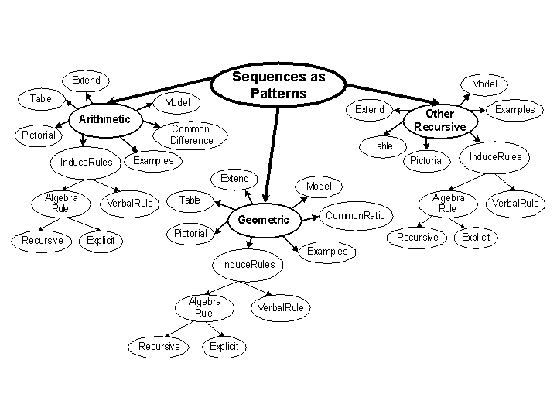
ACED Proficiency Model

Slide 20
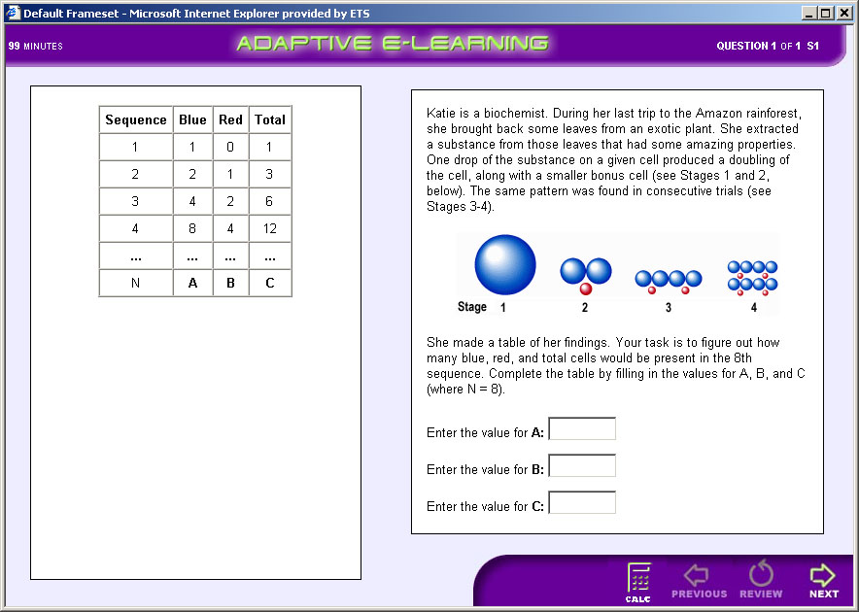
Typical Task

Slide 21
ACED Design/Build Process
Identify Proficiency variables
Structure Proficiency Model
Elicit Proficiency Model Parameters
Construct Tasks to target proficiencies at Low/Medium/High difficulty
Build Evidence Models based on difficulty/Q-Matrix

Slide 22
Parameterization of Network
Proficiency Model:
Based on Regression model of child given parent
SME provided correlation and intercept
SME has low confidence in numeric values
Evidence Model Fragment
Tasks Scored Right/Wrong
Based on IRT model
High/Medium/Low corresponds to θ = +1/0/-1
Easy/Medium/Hard corresponds to difficulty -1/0/+1
Discrimination of 1
Used Q-Matrix to determine which node is parent

Slide 23
PM-EM Algorithm for Scoring
Master Bayes net with just proficiency model(PM)
Database of Bayes net fragments corresponding to evidence models (EMs), indexed by task ID
To score a task:
Find EM fragment corresponding to task
Join EM fragment to PM
Enter Evidence
Absorb evidence from EM fragment into network
Detach EM fragment
Notes:
Can’t detach and discard fragment in Netica, but can do the other steps.
Demonstrate in Netica.
Also support in Ergo and StatShop.

Slide 24
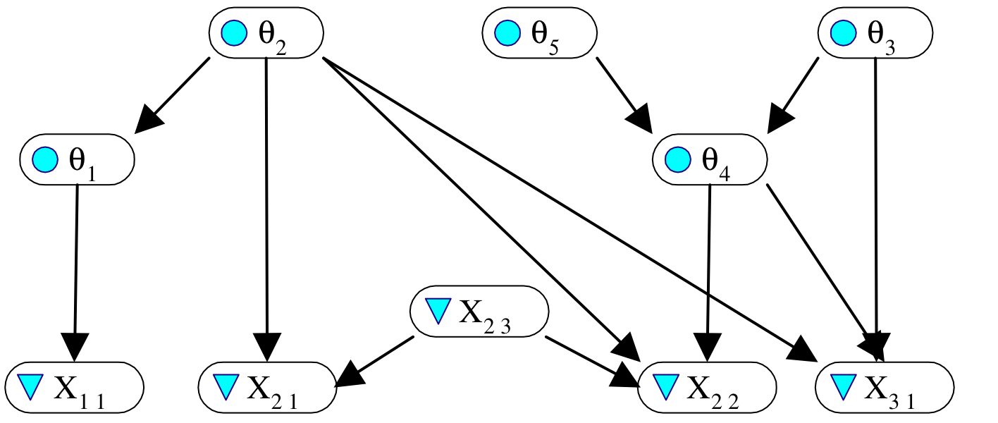
An Example
Five proficiency variables
Three tasks, with observables {X₁₁}, {X₂₁, X₂₂ , X₂₃}, {X₃₁}.

Slide 25
Q: Which observables depend on which proficiency variables? A: See the Q-matrix (Fischer, Tatsuoka).
 | θ₁ | θ₂ | θ₃ | θ₄ | θ₅ | X₂₃
X₁₁ | 1 | 0 | 0 | 0 | 0 | --
X₂₁ | 0 | 1 | 0 | 0 | 0 | 1
X₂₂ | 0 | 1 | 0 | 1 | 0 | 1
X₂₃ | 0 | 0 | 0 | 0 | 0 | N/A
X₃₁ | 0 | 1 | 1 | 1 | 0 | --

Slide 26
Proficiency Model / Evidence Model Split
Full Bayes net for proficiency model and observables for all tasks can be decomposed into fragments.
Proficiency model fragment(s) (PMFs) contain proficiency variables.
An evidence model fragment (EMF) for each task.
EMF contains observables for that task and all proficiency variables that are parents of any of them.
Presumes observables are conditionally independent between tasks, but can be dependent within tasks.
Allows for adaptively selecting tasks, docking EMF to PMF, and updating PMF on the fly.

Slide 27
Generative AI and Bayesian Networks
LLMs can be used to support the implementation of Bayesian Nets.
We present the results of an initial exploration using Bing CoPilot 4.o.

Slide 28
General questions about Bayes nets
Prompt “Provide a definition of a Bayes net with simple examples I the context of educational measurements”
Copilot
A Bayesian Network (Bayes net) is a graphical model that represents a set of variables and their conditional dependencies using a directed acyclic graph (DAG). Each node in the graph represents a random variable, and the edges represent conditional dependencies between these variables. Bayes nets are used for probabilistic reasoning and can efficiently encode joint probability distributions.
Definition
A Bayes net consists of:
Nodes: Represent random variables.
Edges: Directed edges that represent conditional dependencies.
Conditional Probability Tables (CPTs): Each node has a CPT that specifies the probability of the node given its parent nodes.

Slide 29
General questions about Bayes nets
Example in Educational Assessment
Let's consider an example involving student performance in an educational setting:
Variables:
Study Hours (S): The number of hours a student studies.
Class Attendance (A): Whether the student attends classes regularly.
Exam Performance (E): The student's performance in exams.
Structure:
S and A are parent nodes.
E is a child node dependent on S and A.
Conditional Probability Tables (CPTs):
Study Hours (S):
P(S = High) = 0.6
P(S = Low) = 0.4
Class Attendance (A):
P(A = Regular) = 0.7
P(A = Irregular) = 0.3

Slide 30
General questions about Bayes nets
Exam Performance (E) given S and A:
P(E = Good | S = High, A = Regular) = 0.9
P(E = Good | S = High, A = Irregular) = 0.7
P(E = Good | S = Low, A = Regular) = 0.6
P(E = Good | S = Low, A = Irregular) = 0.2
Graphical Representation
S --> E <-- A
Interpretation
Study Hours (S) and Class Attendance (A) directly influence Exam Performance (E).
The CPT for E shows how the for modeling complex dependencies and making probabilistic inferences, especially in educational assessments where multiple factors influence student outcomes
1probabilities of E being "Good" change based on the states of S and A.
Bayesian Networks are powerful tools
2
3

Slide 31
Conditional Probability Tables
Prompt “Generate a Conjunctive, a Disjunctive, and a Compensatory conditional probability tables for a node C that has two parents A and B. All nodes A. B and C have two states, Correct and Incorrect. Please generate the tables in excel format”
Copilot
I've created the Conjunctive, Disjunctive, and Compensatory conditional probability tables for node C with parents A and B, where all nodes have states "Correct" and "Incorrect". You can download the Excel file containing these tables using the link below:
Download conditional_probability_tables.xlsx

Slide 32
Conditional Probability Tables
Compensatory
Disjunctive
Conjunctive

Slide 33
Changing Probabilities and Computing Marginal Probabilities
Prompt “Use the following prior probabilities for A. P(A = "Correct") = 0.75; P(A = "Incorrect") = 0.25; Use the following prior probabilities for B. P(B = "Correct") = 0.65; P(B = "Incorrect") = 0.35. Produce python code for computing marginal probabilities for each generated CTP”
Copilot
… code

Slide 34
Python Code - Compensatory
import pandas as pd
# Define the states
states = ["Correct", "Incorrect"]
# Define the Compensatory CPT
compensatory_cpt = {
("Correct", "Correct"): [0.9, 0.1],
("Correct", "Incorrect"): [0.7, 0.3],
("Incorrect", "Correct"): [0.7, 0.3],
("Incorrect", "Incorrect"): [0.1, 0.9]
}
# Define the prior probabilities for A and B
prior_A = {"Correct": 0.75, "Incorrect": 0.25}
prior_B = {"Correct": 0.65, "Incorrect": 0.35}
# Function to compute marginal probabilities for a given CPT
def compute_marginal_probabilities(cpt):
marginal_C = {state: 0 for state in states}
for (a_state, b_state), probs in cpt.items():
for c_state, prob in zip(states, probs):
marginal_C[c_state] += prob * prior_A[a_state] * prior_B[b_state]
return marginal_C
# Compute marginal probabilities for Compensatory CPT
marginal_C_compensatory = compute_marginal_probabilities(compensatory_cpt)
print("Marginal probabilities for C using Compensatory CPT:")
print(marginal_C_compensatory)

Slide 35

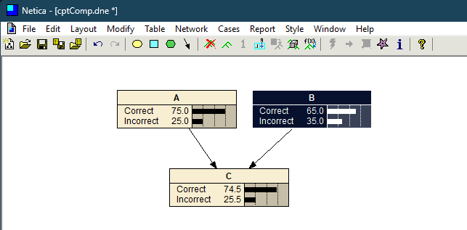
Marginal Probability for C - Compensatory

Slide 36
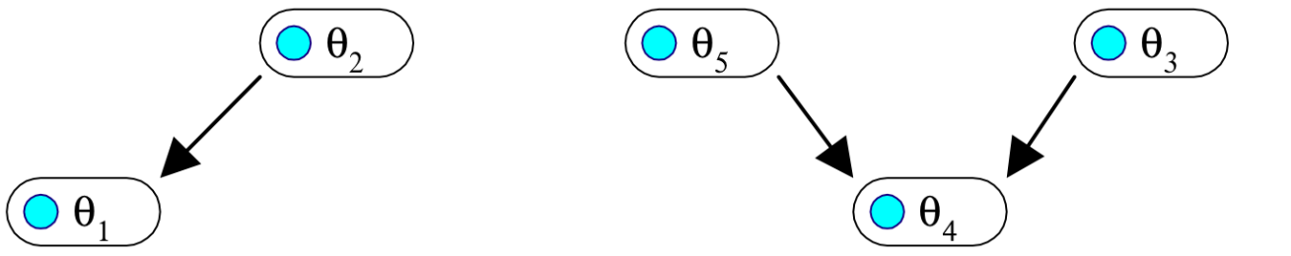
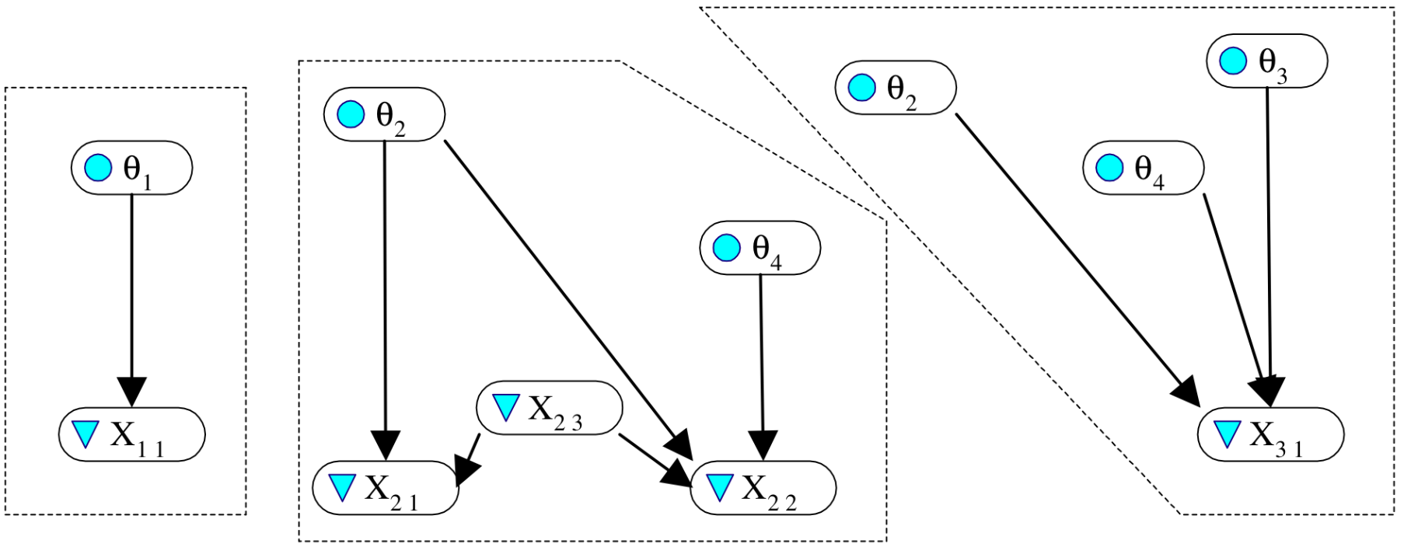
On the way to PMF and EMFs…
Proficiency variables
Observables and proficiency variable parents for the tasks

Slide 37
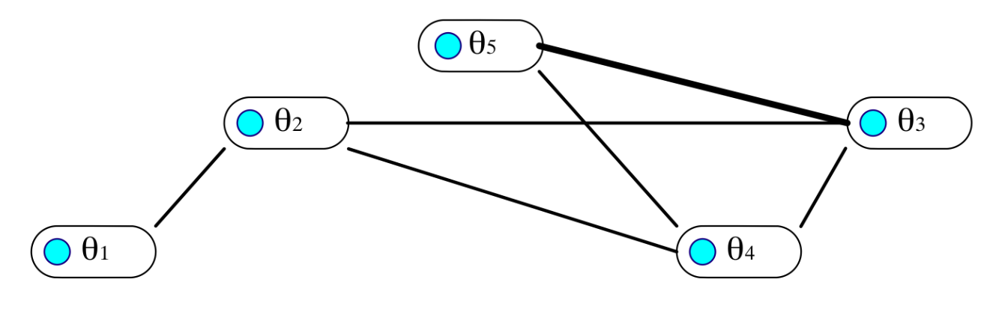
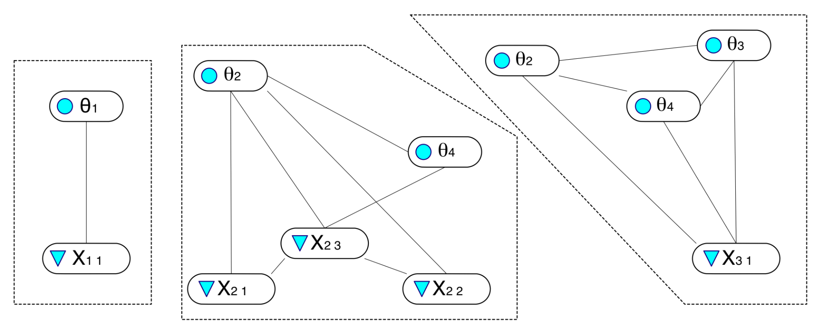
Marry parents, drop directions, and triangulate (in PMF, with respect to all tasks)
PMF
EMF₁
EMF₂
EMF₃

Slide 38
Footprints of tasks in proficiency model (figure out from rows in Q-matrix)

Slide 39
Result:
Each EMF implies a join tree for Bayes net propagation.
Initial distributions for proficiency variables are uniform.
The footprint of the PM in the EMF is a clique intersection between that EMF and the PMF.
Can “dock” EMFs with PMF one-at-a-time, to …
absorb evidence from values of observables to that task as updated probabilities for proficiency variables, and
predict responses in new tasks, to evaluate potential evidentiary value of administering it.

Slide 40
Docking evidence model fragments
θ₅
θ₂
θ₃
θ₁
θ₄
PMF
θ₂
θ₂
θ₃
θ₄
θ₄
X₃₁
X₂₃
X₂₂
X₂₁

Slide 41
Scoring Exercise
Outcome | Task Name | Proficiency Variable | Difficulty
Wrong | tCommonRatio1a.xml | CommonRatio | Easy
Right | tCommonRatio2b.xml | CommonRatio | Medium
Wrong | tCommonRatio3b.xml | CommonRatio | Hard
Wrong | tExplicitGeometric1a.xml | ExplicitGoemetric | Easy
Right | tExplicitGeometric2a.xml | ExplicitGoemetric | Medium
Wrong | tExplicitGeometric3b.xml | ExplicitGoemetric | Hard
Wrong | tRecursiveRuleGeometric1a.xml | RecursiveRuleGeometric | Easy
Wrong | tRecursiveRuleGeometric2b.xml | RecursiveRuleGeometric | Medium
Wrong | tRecursiveRuleGeometric3a.xml | RecursiveRuleGeometric | Hard
Right | tTableExtendGeometric1a.xml | TableGeometric | Easy
Right | tTableExtendGeometric2b.xml | TableGeometric | Medium
Right | tTableExtendGeometric3a.xml | TableGeometric | Hard
Wrong | tVerbalRuleExtendModelGeometric1a.xml | VerbalRuleGeometric | Easy
Wrong | tVerbalRuleExtendModelGeometric1b.xml | VerbalRuleGeometric | Easy
Right | tVerbalRuleExtendModelGeometric2a.xml | VerbalRuleGeometric | Medium
Wrong | tVisualExtendGeometric1a.xml | VisualGeometric | Easy
Wrong | tVisualExtendGeometric2a.xml | VisualGeometric | Medium
Wrong | tVisualExtendGeometric3a.xml | VisualGeometric | Hard
Notes:
This is a fragment of a transcript from an ACED student using the linear method. Score this student.

Slide 42

Weight of Evidence
Good (1985)
H is binary hypothesis, e.g., Proficiency > Medium
E is evidence for hypothesis
Weight of Evidence (WOE) is

Slide 43
Properties of WOE
“Centibans” (log base 10, multiply by 100)
Positive for evidence supporting hypothesis, negative for evidence refuting hypothesis
Movement in tails of distribution as important as movement near center
Bayes theorem using log odds

Slide 44

Conditional Weight of Evidence
Can define Conditional Weight of Evidence
Nice Additive properties
Order sensitive
WOE Balance Sheet (Madigan, Mosurski & Almond, 1997)

Slide 45


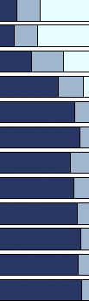
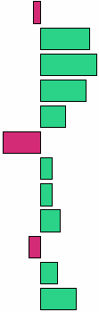
Evidence Balance Sheet
63 tasks total
1 Easy
2 Medium
3 Hard
a Item type
b Isomorph
P(Solve Geom Sequences)
_{H}
_{M}
_{L}
Task | Acc | H | M | L
SolveGeometricProblems2a | 0 | 0.16 | 0.26 | 0.58
SolveGeometricProblems3a | 1 | 0.35 | 0.35 | 0.30
SolveGeometricProblems3b | 1 | 0.64 | 0.29 | 0.07
SolveGeometricProblems2b | 1 | 0.83 | 0.16 | 0.01
VisualExtendTable2a | 1 | 0.89 | 0.10 | 0.01
SolveGeometricProblems1a | 0 | 0.78 | 0.21 | 0.01
SolveGeometricProblems1b | 1 | 0.82 | 0.18 | 0.00
VisualExtendVerbalRule2a | 1 | 0.85 | 0.15 | 0.00
ModelExtendTableGeometric3a | 1 | 0.90 | 0.10 | 0.00
ExamplesGeometric2a | 0 | 0.87 | 0.13 | 0.00
VisualExplicitVerbalRule3a | 1 | 0.91 | 0.09 | 0.00
VerbalRuleModelGeometric3a | 1 | 0.95 | 0.05 | 0.00
WOE for H vs. M, L
.
.
.
Notes:
Madigan, Mosurski and Almond [1996]
Thanks to Val for cleanup.

Slide 46

Expected Weight of Evidence
When choosing next “test” (task/item) look at expected value of WOE where expectation is taken wrt P(E|H).
where represent the possible results.

Slide 47
Calculating EWOE
Madigan and Almond (1996)
Enter any observed evidence into net
Instantiate Hypothesis = True (may need to use virtual evidence if hypothesis is compound)
Calculate for each candidate item
Instantiate Hypothesis = False
Calculate for each candidate item

Slide 48

Related Measures
Value of Information
S is proficiency state
d is decision
u is utility
Notes:
Drawback is it requires formal utilities.
EWOE is a quasi-utility

Slide 49


Related Measures (2)
Mutual Information
Extends to non-binary hypothesis nodes
Kullback-Liebler distance between joint distribution and independence

Slide 50
Task Selection Exercise 1
Use ACEDMotif1.dne
Easy, Medium, and Hard tasks for Common Ratio and Visual Geometric
Use Hypothesis SolveGeometricProblems > Medium
Calculate EWOE for six observables
Assume candidate gets first item right and repeat
Next assume candidate gets first item wrong and repeat
Repeat exercise using hypothesis SolveGeometricProblems > Low

Slide 51
Task Selection Exercise 2
Use Network ACEDMotif2.dne
Select the SolveGeometricProblems node
Run the program Network>Sensitivity to Findings
This will list the Mutual information for all nodes
Select the observable with the highest mutual information as the first task
Use this to process a person who gets every task right
Use this to process a person who gets every task wrong
Notes:
Note: This procedure doesn’t work on the Mac Version.

Slide 52
ACED Evaluation
Middle School Students
Did not normally study geometric series
Four conditions:
Elaborated Feedback/Adaptive (E/A; n=71)
Simple Feedback/Adaptive (S/A; n=75)
Elaborated Feedback/Linear (E/L; n=67)
Control (no instruction; n=55)
Students given all 61 geometric items
Also given pretest/posttest (25 items each)

Slide 53
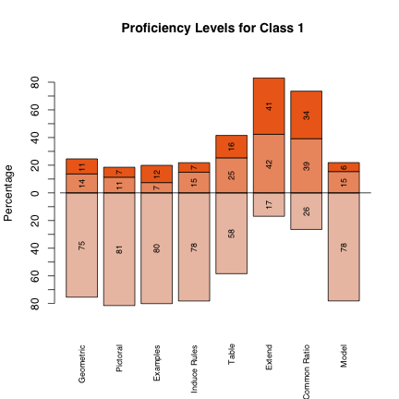
ACED Scores
For Each Proficiency Variable
Marginal Distribution
Modal Classification
EAP Score (High=1, Low=-1)

Slide 54
ACED Reliability
Proficiency (EAP) | Reliability
Solve Geometric Sequences (SGS) | 0.88
Find Common Ratio | 0.90
Generate Examples | 0.92
Extend Sequence | 0.86
Model Sequence | 0.80
Use Table | 0.82
Use Pictures | 0.82
Induce Rules | 0.78
Number Right | 0.88
Calculated with Split Halves (ECD design)
Correlation of EAP score with posttest is 0.65 (close to reliability of posttest)
Even with pretest forced into the equation, EAP score accounted for 17% unique variance
Reliability of modal classifications was worse

Slide 55
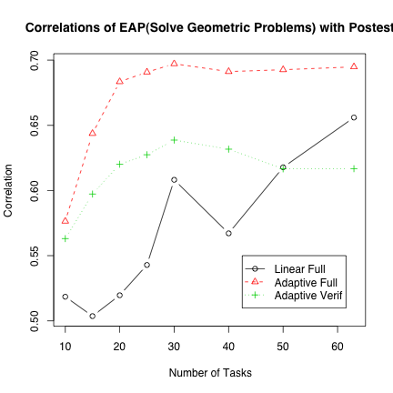
Effect of Adaptivity
For adaptive conditions, correlation with posttest seems to hit upper limit by 20 items
Standard Error of Correlations is large
Jump in linear case related to sequence of items

Slide 56
Effect of feedback
E/A showed significant gains
Others did not
Learning and assessment reliability!!!!!

Slide 57
Acknowledgements
Special thanks to Val Shute for letting us used ACED data and models in this tutorial.
ACED development and data collection was sponsored by National Science Foundation Grant No. 0313202.
Complete data available at: http://ecd.ralmond.net/ecdwiki/ACED/ACED

